Slide 1


Real World Interactive Learning
Alekh Agarwal
John Langford
ICML Tutorial, August 6
Slides and full references at http://hunch.net/~rwil

Slide 2
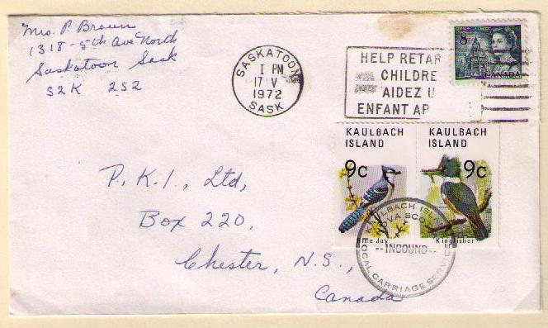
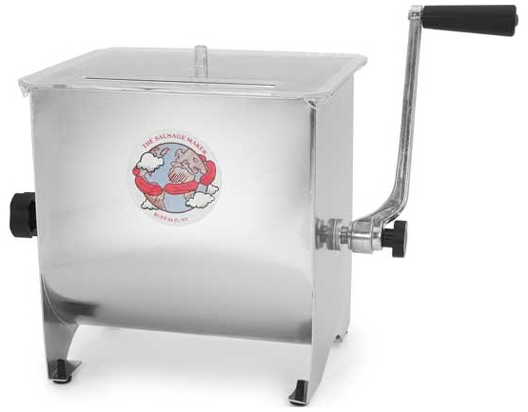
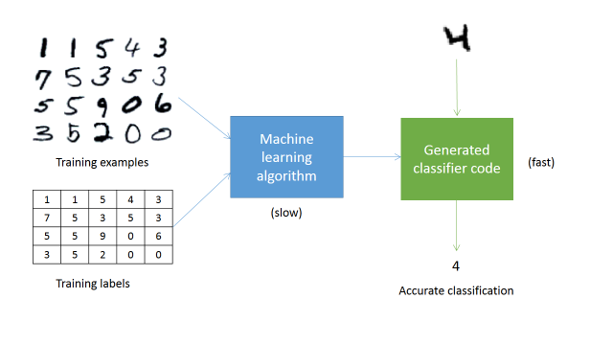
The Supervised Learning Paradigm
1 | 1 | 5 | 4 | 3
7 | 5 | 3 | 5 | 3
5 | 5 | 9 | 0 | 6
3 | 5 | 2 | 0 | 0
Accurate digit classifier
Training examples
Training labels
Supervised Learner
2
Notes:
ML takes a different approach. By applying concepts from a range of fields, including statistics, probability theory, and so on, we can build an ML system that “learns” to recognize handwritten digits by being trained on thousands, or even millions, of examples.
So, in order to get an accurate digit classifier, all we need to do is acquire lots of training examples, with labels (this is called “labeled training data”), and then feed it into the ML system.

Slide 3
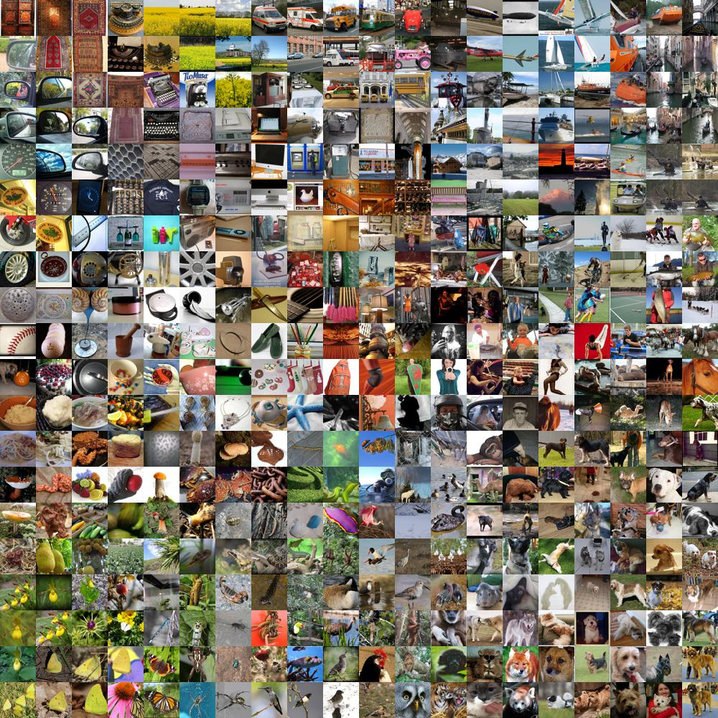
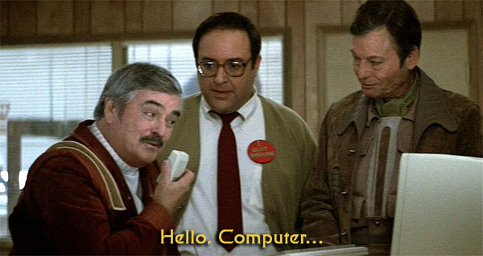
Supervised Learning is cool

Slide 4

How about news?
Repeatedly:
Observe features of user+articles
Choose a news article.
Observe click-or-not
Goal: Maximize fraction of clicks
Notes:
Add Wellness

Slide 5
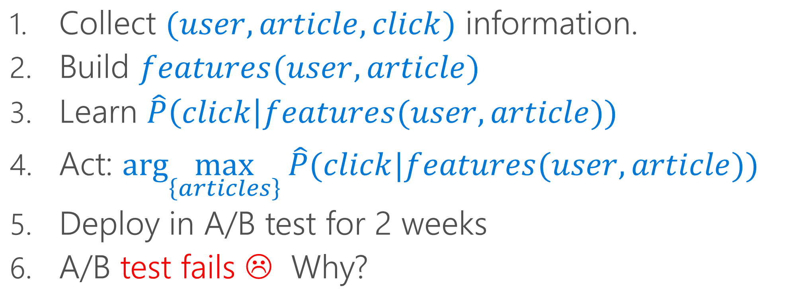
A standard pipeline
Collect $(user, article, click)$ information.
Build $features(user,article)$
Learn $\hat{P}\left(click\right|features(user,article))$
Act: $arg\max_{\left\{articles\right\}} \hat{P}(click|features(user,article))$
Deploy in A/B test for 2 weeks
A/B test fails ☹ Why?

Slide 6
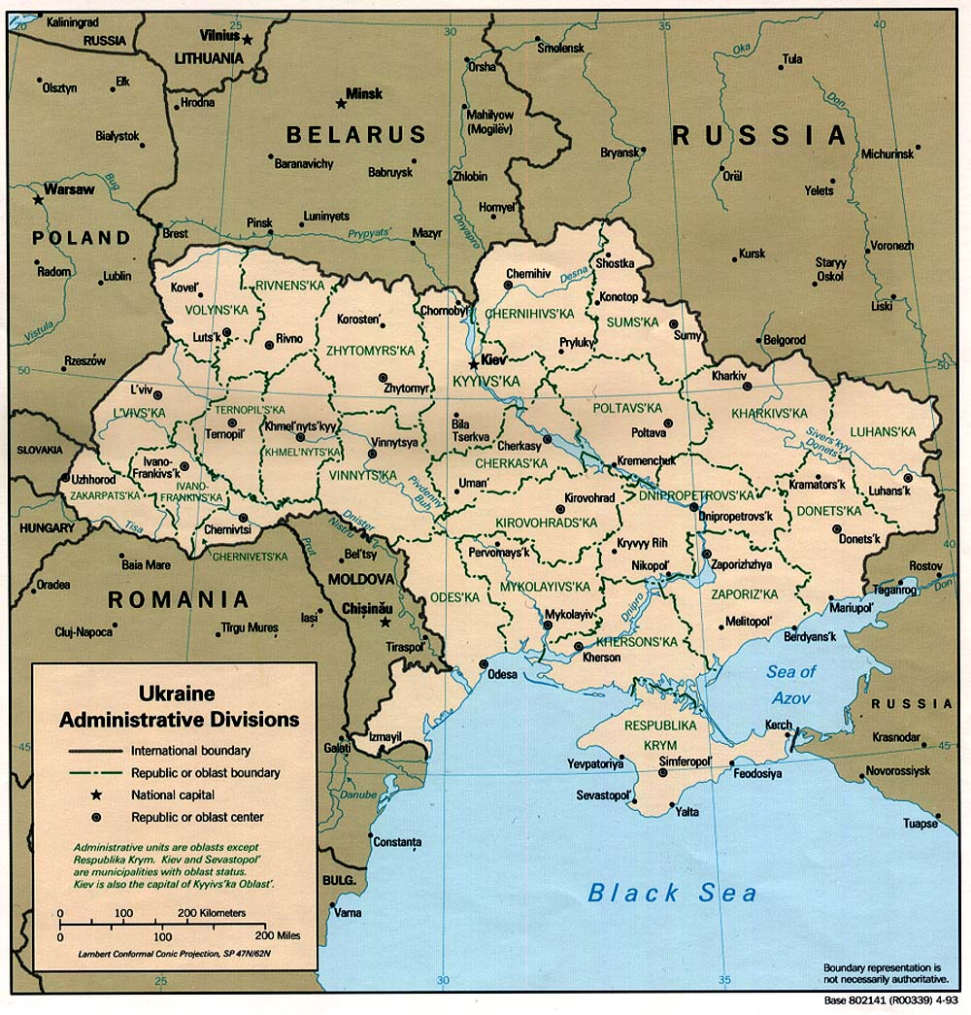

Q: What goes wrong?
Is Ukraine interesting to John ?
A: Need Right Signal for Right Answer

Slide 7
Q: What goes wrong?
Model value over time
A: The world changes!

Slide 8

Interactive Learning
Action
(selected news story)
Learning
Features
(user history, news stories)
Consequence
(click-or-not)

Slide 9
Q: Why Interactive Learning?
A: $$$
Use free interaction data
rather than expensive labels

Slide 10

Q: Why Interactive Learning?
AI: A function programmed with data
AI: A function programmed with data
AI: An economically viable digital agent that explores, learns, and acts

Slide 11
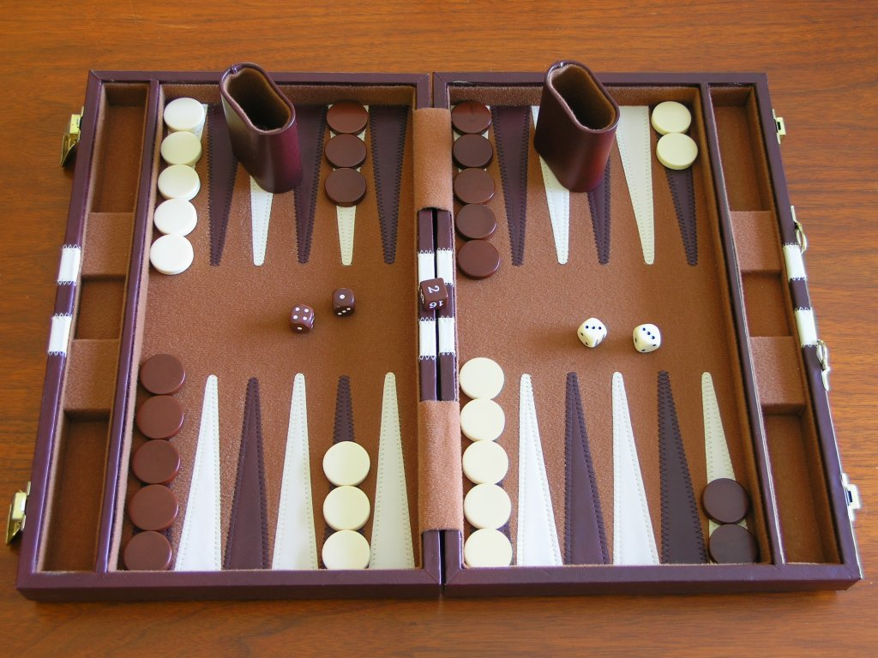
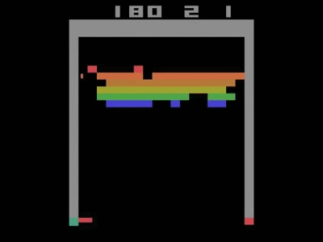
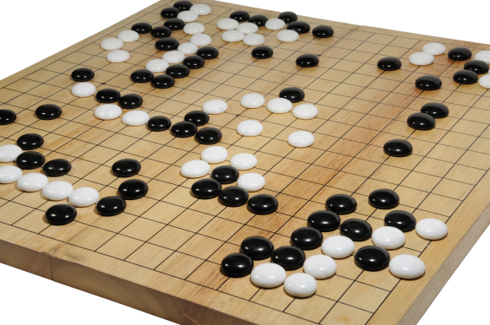
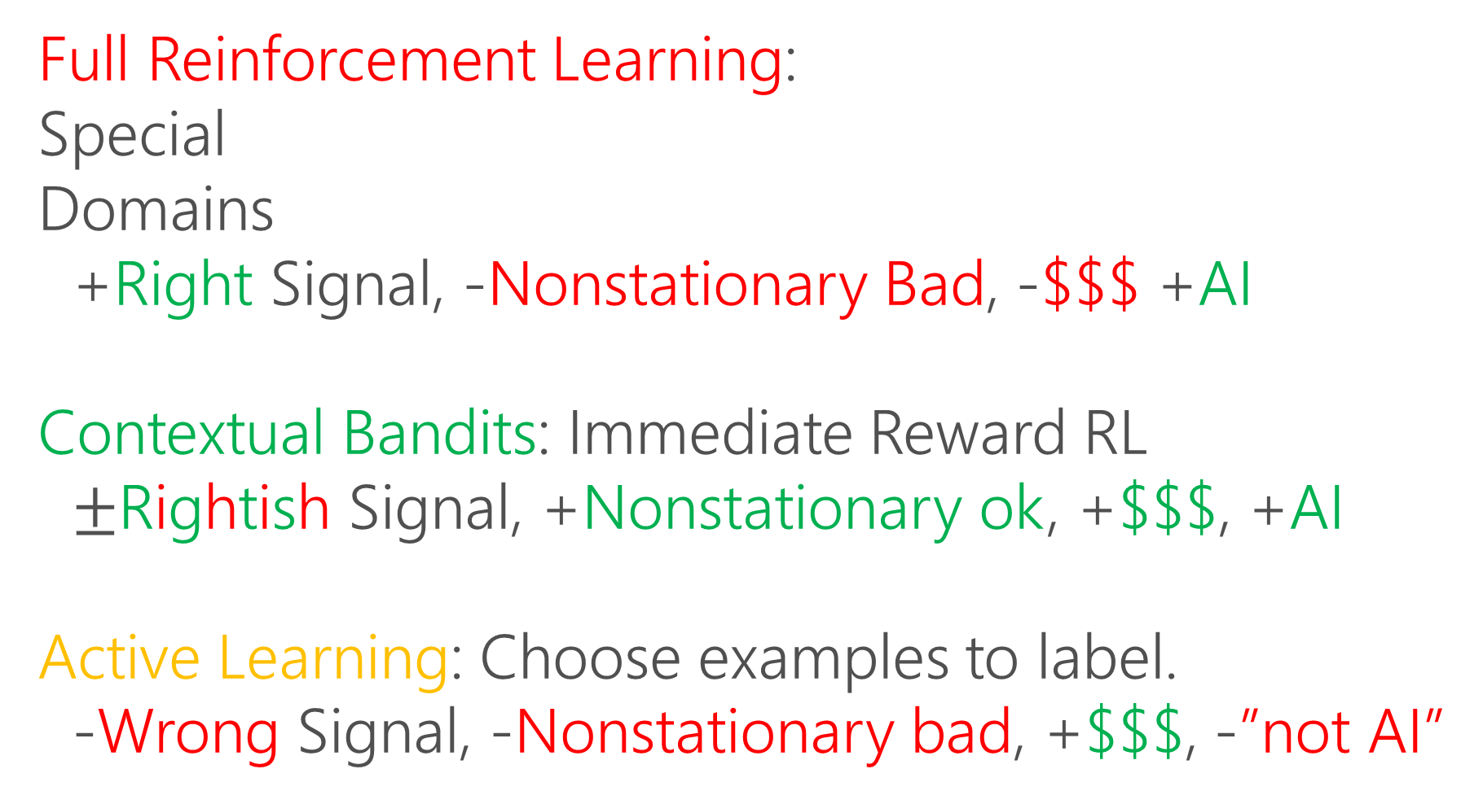
Flavors of Interactive Learning
Full Reinforcement Learning:
Special
Domains
+Right Signal, -Nonstationary Bad, -$$$ +AI
Contextual Bandits: Immediate Reward RL
$±$Rightish Signal, +Nonstationary ok, +$$$, +AI
Active Learning: Choose examples to label.
-Wrong Signal, -Nonstationary bad, +$$$, -”not AI”
Notes:
Revisit after motivations

Slide 12

Ex: Which advice?
Repeatedly:
Observe features of user+advice
Choose an advice.
Observe steps walked
Goal: Healthy behaviors

Slide 13
Other Real-world Applications
News Rec: [LCLS ‘10]
Ad Choice: [BPQCCPRSS ‘12]
Ad Format: [TRSA ‘13]
Education: [MLLBP ‘14]
Music Rec: [WWHW ‘14]
Robotics: [PG ‘16]
Wellness/Health: [ZKZ ’09, SLLSPM ’11, NSTWCSM ’14, PGCRRH ’14, NHS ’15, KHSBATM ‘15, HFKMTY ’16]

Slide 14
Take-aways
Good fit for many real problems

Slide 15
Outline
Algs & Theory Overview
Evaluate?
Learn?
Explore?
Things that go wrong in practice
Systems for going right
Really doing it in practice

Slide 16
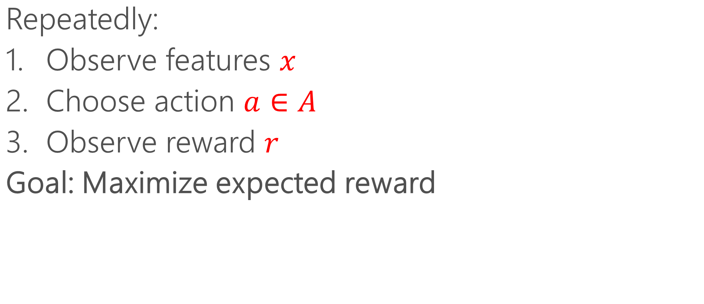
Contextual Bandits
Repeatedly:
Observe features $x$
Choose action $a∈A$
Observe reward $r$
Goal: Maximize expected reward

Slide 17


Policies
Policy maps features to actions.
Policy = Classifier that acts.

Slide 18


Exploration
Policy

Slide 19
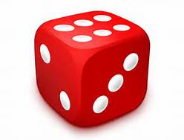
Exploration
Randomization
Policy

Slide 20

Exploration
Randomization
Policy

Slide 21
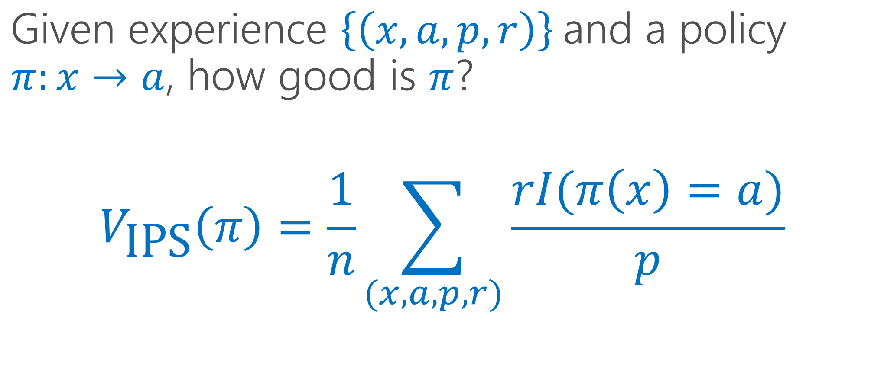
Inverse Propensity Score(IPS) [HT ‘52]
Given experience ${\left.\left\{\left(x,a,p,r\right)\right.\right\}}^{ }$and a policy $π:x→a$, how good is $π$?
$$V_{\text{IPS}}\left(π\right)=\frac{1}{n}\sum_{(x,a,p,r)}{\frac{rI(π\left(x\right)=a)}{p}}$$
Propensity Score

Slide 22
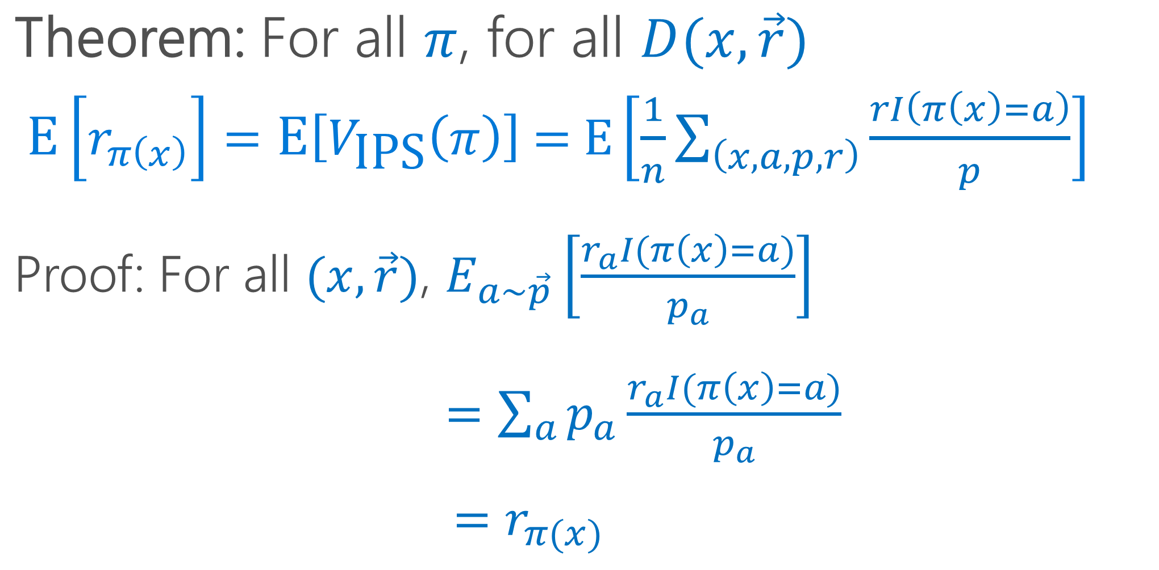
What do we know about IPS?
Theorem: For all $π$, for all $D(x,\vec{r})$
$\left.\text{E}\left[r_{π\left(x\right)}\right.\right]=\text{E}\left.\left[V_{\text{IPS}}\left(π\right)\right.\right]\text{ = }\text{E}\left[\frac{1}{n}\sum_{\left(x,a,p,r\right)}{\frac{rI\left(π\left(x\right)=a\right)}{p}}\right]$
Proof: For all $(x,\vec{r})$, $E_{a∼\vec{p}}\left[\frac{r_{a}I(π\left(x\right)=a)}{p_{a}}\right]$
$=\sum_{a}{p_{a}\frac{r_{a}I(π\left(x\right)=a)}{p_{a}}}$
$=r_{π(x)}$

Slide 23
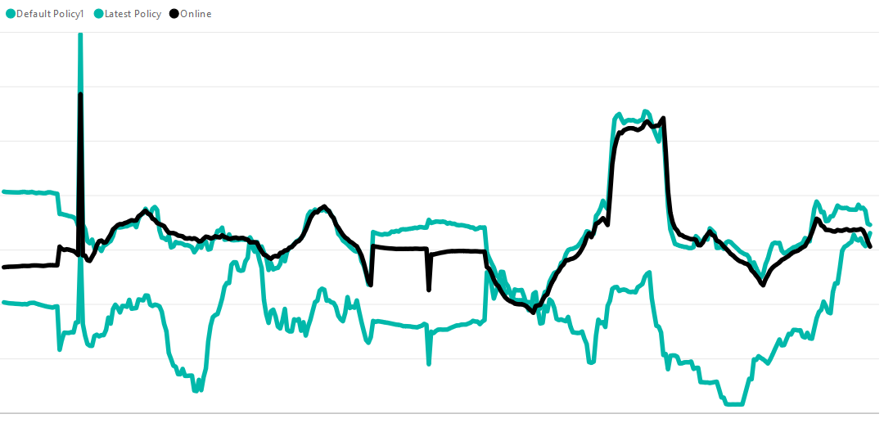
Reward over time
System’s actual online performance
Offline estimate of system’s performance
Offline estimate of baseline’s performance
Notes:
Add reference slide for evaluation

Slide 24
Better Evaluation Techniques
Double Robust: [DLL ‘11]
Weighted IPS: [K ’92, SJ ‘15]
Clipping: [BL ’08]

Slide 25
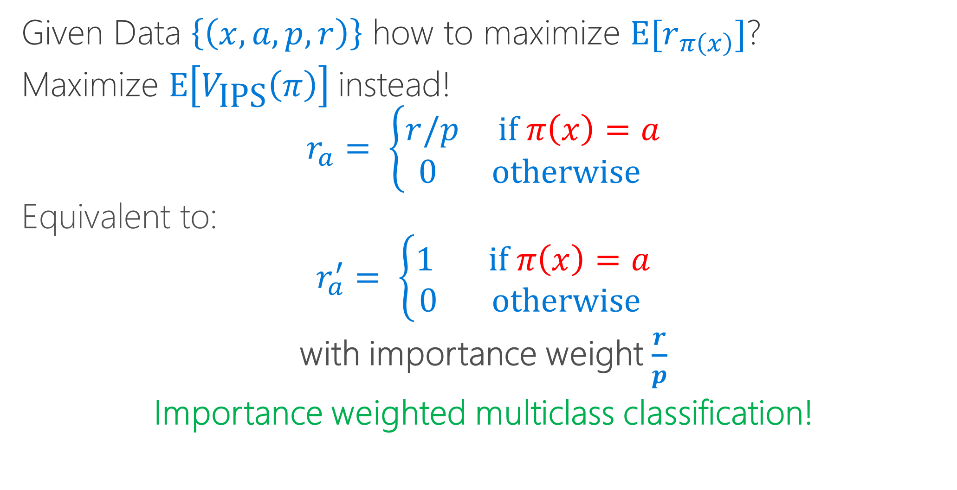
Learning from Exploration [‘Z 03]
Given Data $\left\{\left(x, a, p,r\right)\right\}$ how to maximize $\text{E}[r_{π\left(x\right)}]$?
Maximize $\text{E}\left[V_{\text{IPS}}\left(π\right)\right]$ instead!
$$r_{a}= \left\{\begin{aligned}r/p \text{if} π\left(x\right)=a \\ 0 \text{otherwise} \end{aligned}\right.$$
Equivalent to:
$$r_{a}^{′}= \left\{\begin{aligned}1 \text{if} π\left(x\right)=a \\ 0 \text{otherwise} \end{aligned}\right.$$
with importance weight $\frac{r}{p}$
Importance weighted multiclass classification!

Slide 26












Vowpal Wabbit: Online/Fast learning
BSD License, 10 year project
Mailing List>500, Github>1K forks, >4K stars, >1K issues, >100 contributors
Command Line/C++/C#/Python/Java/AzureML/Daemon

Slide 27
VW for Contextual Bandit Learning
echo “1:2:0.5 | here are some features” | vw --cb 2
Format: <action>:<loss>:<probability> | features…
Training on a large dataset:
vw --cb 2 rcv1.cb.gz --ngram 2 --skips 4 -b 24
Result: 0.048616

Slide 28
Better Learning from Exploration Data
Policy Gradient: [W ‘92]
Offset Tree: [BL ’09]
Double Robust for learning: [DLL ‘11]
Multitask Regression: Unpublished, but in Vowpal Wabbit
Weighted IPS for learning: [SJ ‘15]

Slide 29
Evaluating Online Learning
Problem: How do you evaluate an online learning algorithm Offline?
Answer: Use Progressive Validation [BKL ’99, CCG ‘04]
Theorem:
1) Expected PV value = Uniform expected policy value.
2) Trust like a test set error.

Slide 30
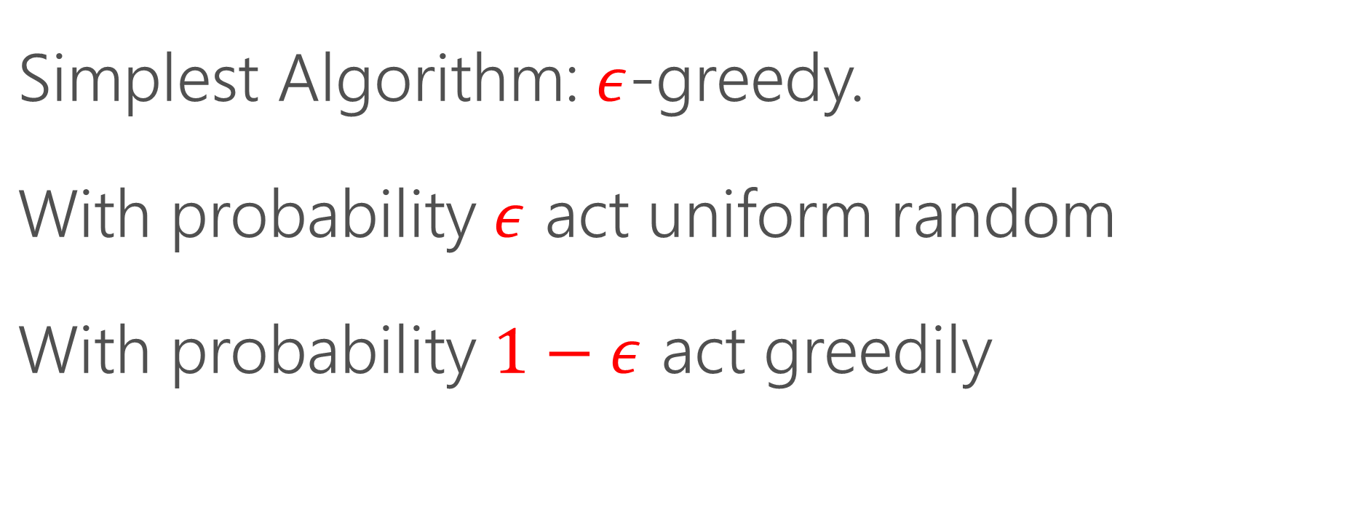
How do you do Exploration?
Simplest Algorithm: $ε$-greedy.
With probability $ε$ act uniform random
With probability $1−ε$ act greedily

Slide 31
Better Exploration Algorithms
Better algorithms maintain ensemble and explore amongst actions of this ensemble.
Thompson Sampling: [T ‘33]
EXP4: [ACFS ‘02]
Epoch Greedy: [LZ ‘07]
Polytime: [DHKKLRZ ‘11]
Cover&Bag: [AHKLLS ‘14]
Bootstrap: [EK ‘14]

Slide 32
Evaluating Exploration Algorithms
Problem: How do you take the choice of examples acquired by an exploration algorithm into account?
Answer: Rejection Sample from history. [DELL ‘12]
Theorem: Realized history is unbiased up to length observed.
Better versions: [DELL ‘14] & VW code

Slide 33
More Details!
NIPS tutorial: http://hunch.net/~jl/interact.pdf
John’s Spring 2017 Cornell Tech class (http://hunch.net/~mltf) with slides and recordings
[Forthcoming] Alekh’s Fall 2017 Columbia class with extensive class notes.

Slide 34
Take-aways
Good fit for many problems
Fundamental questions have useful answers

Slide 35


